Slide 1
XEON
CMS over Messaging
Abhishek Gupta
Pranjal Jain

Slide 2
Table Of Content
Overview
Project Overview
Target Audience
Modules
Technical Aspects
Architecture Model

Slide 3
Overview
XEON : Concise Article Website
Messaging as a platform (Telegram App)
Public managed content
Admin control over permission to modification of content
Additional Services to Contributors

Slide 4
Project objective
Build a content driven website for articles
Proper organisation of content based on different categories
Provide a easy means to user to add / delete / modify the contents using a messaging platform
Admin Portal for easy and fast control over the articles

Slide 5
Target audience
Bloggers
General Knowledge Seekers

Slide 6
Modules
04
Telegram API Server
Website using Wordpress
Implemented using PYTHON
Website to view content of the database
01
03
MySQL Database
Admin Portal within Telebot
To store content of the blogs
Grant access to R/W database
02

Slide 7
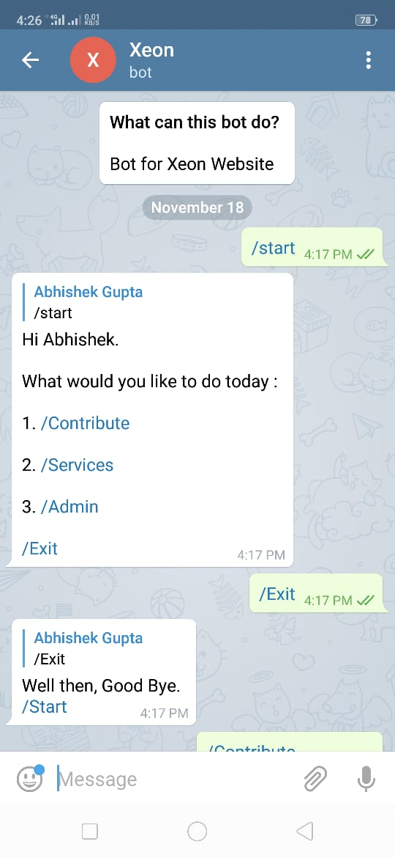
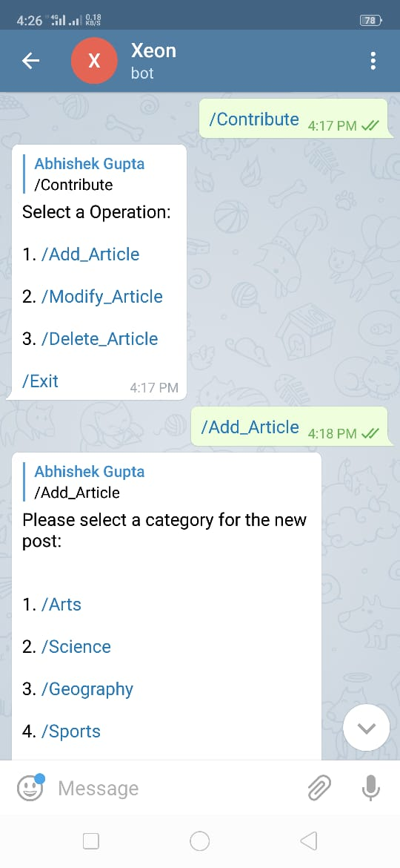
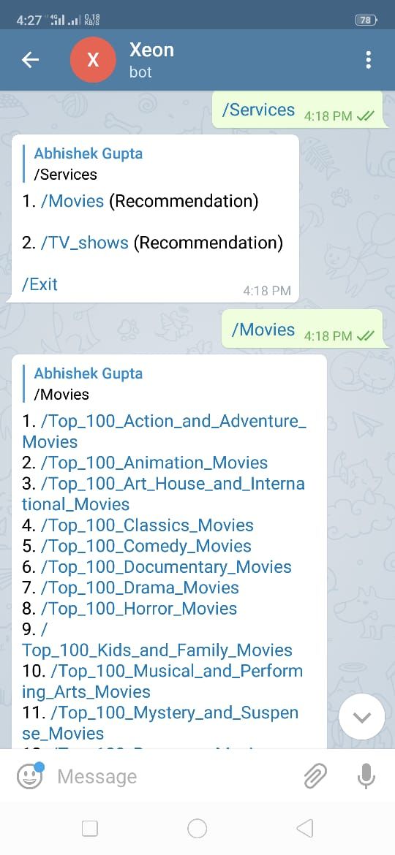
Contributor Interface :
XeonTeleBot in Telegram
Create username
Contribute
Add Article
Modify Article
Delete Own Article
Services
TV Show Recommendation
Movie Recommendation

Slide 8
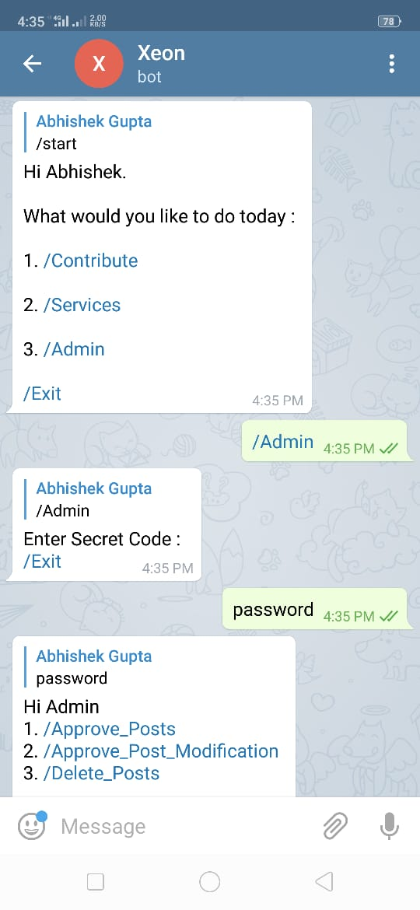
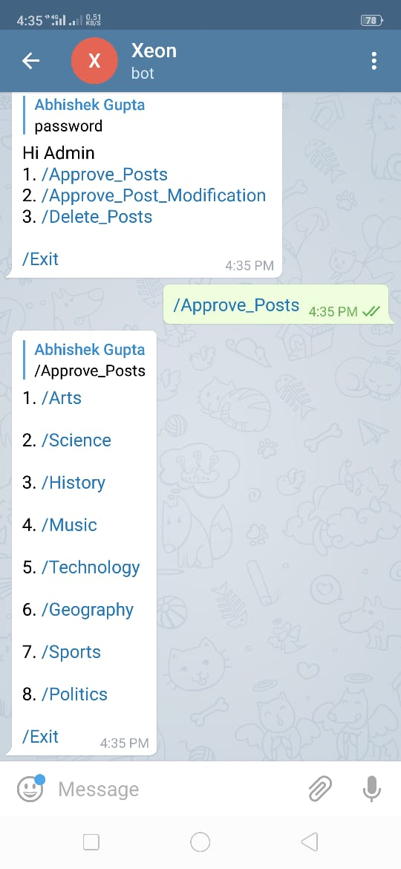
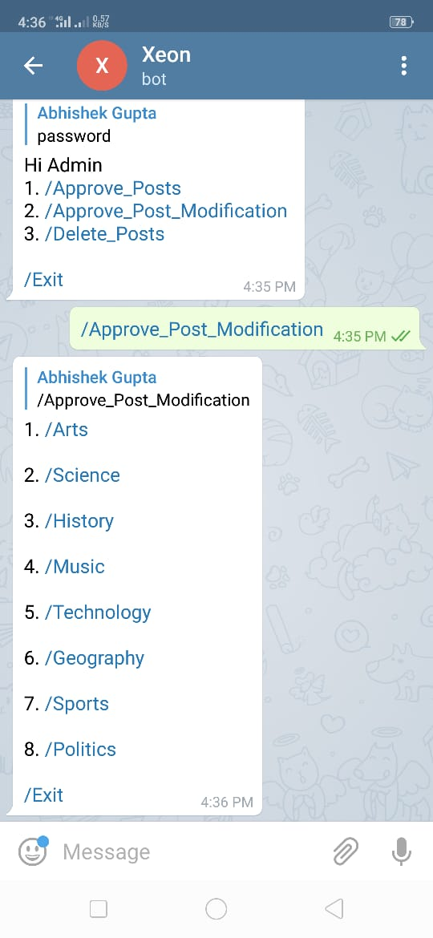
Admin Interface :
XeonTeleBot in Telegram
Give access to admin portal via secret code
Operations
Approve article publish
Approve article modification
Delete published articles

Slide 9
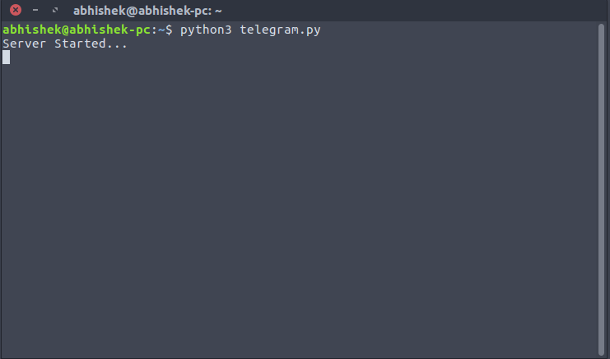
Python Telegram API Implementation
Implements Telebot API
Can handle multiple clients at once as multiple threads are being created
Contains all the logic to handle Content Management

Slide 10
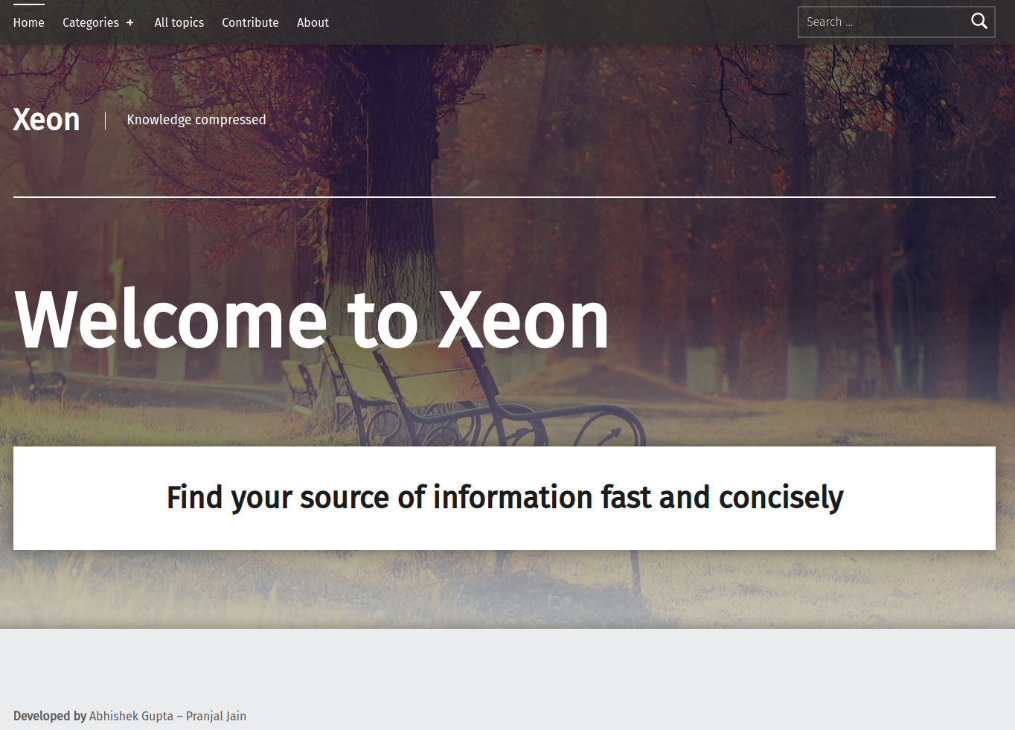
Website
Over Wordpress
Topics divided into 8 categories
Search facility
Modern design
Topics can also be viewed based on author.
MySQL database used in backend

Slide 11

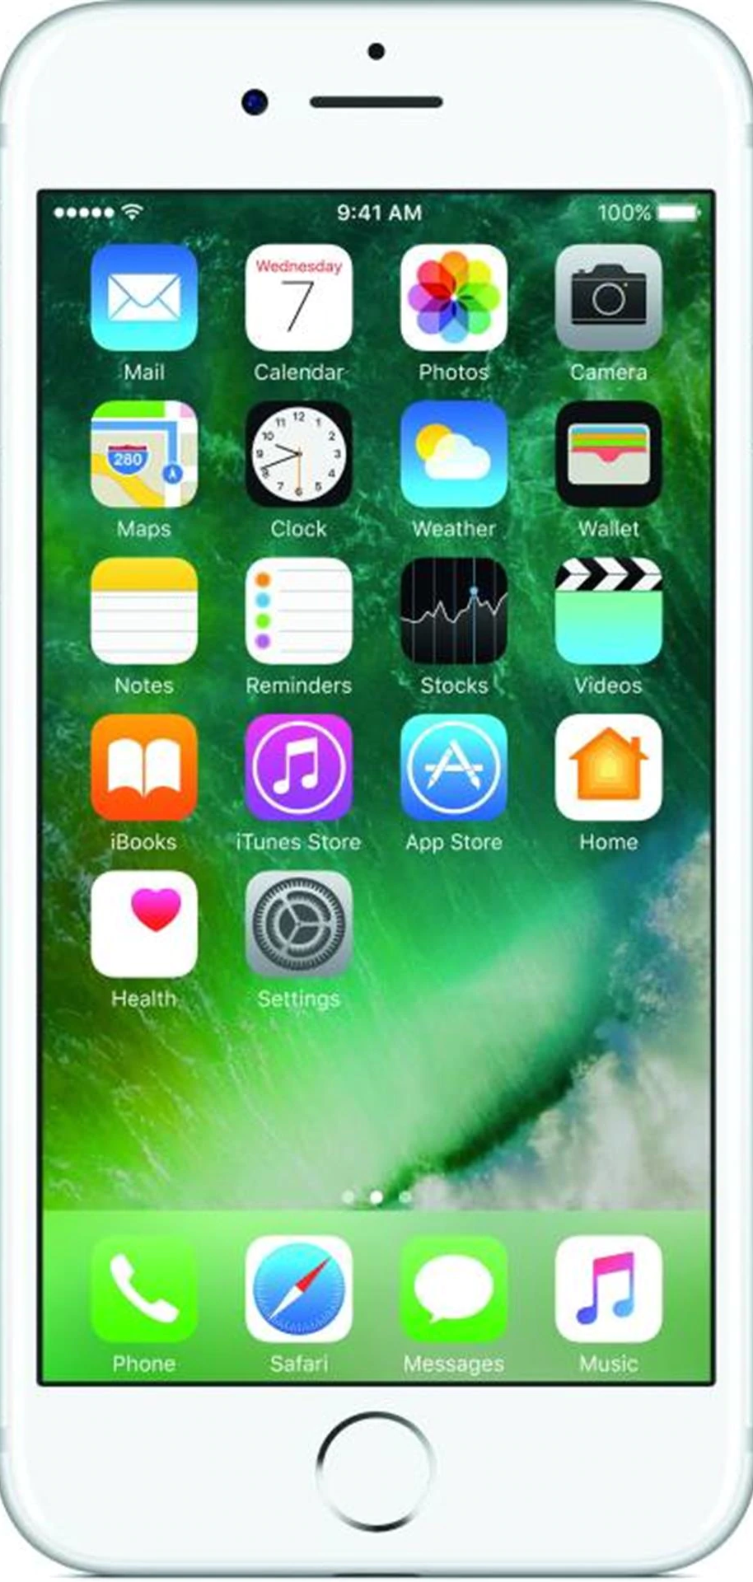


Architecture Model
Telegram Server
Website Users
(View Only)
User
(R/W Blog)
Python Server
Database
Admin
(Authoritative Control)
Blog Website

Slide 12

Thank you!

